Slide 1
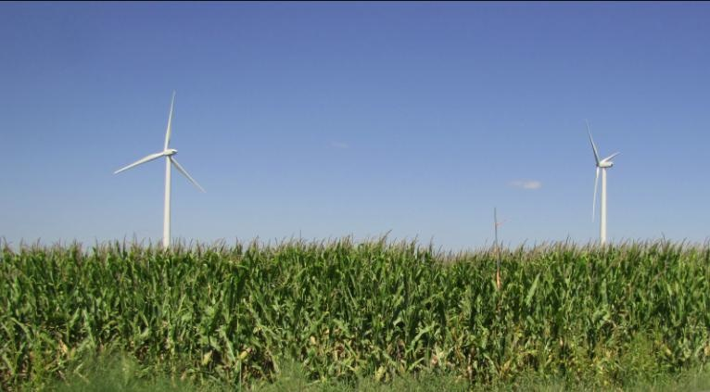
Crop/Wind-energy EXperiment (CWEX):
Results from CWEX10/11 and Vision for the Future
Eugene S. Takle
Department of Agronomy
Department of Geological and Atmospheric Science
Director, Climate Science Program
Iowa State University
National Wind Technology Center
National Renewable Energy Laboratory
Golden, CO
21 August 2012

Slide 3
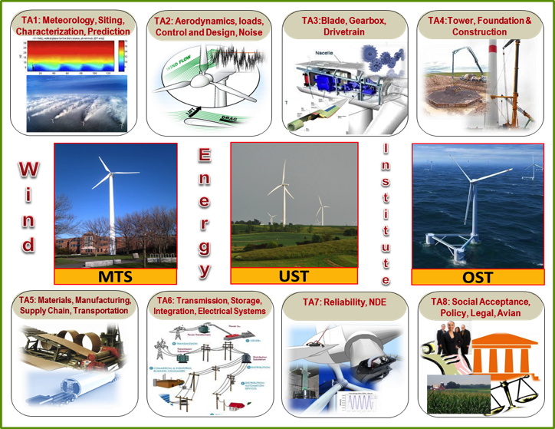
CWEX: A Component of the ISU College of Engineering Wind Energy Initiative

Slide 4
CWEX Participants
National Laboratory for Agriculture
and the Environment
John Prueger
Jerry Hatfield
Richard Pfeiffer
Forest Goodman
Iowa State University
Dan Rajewski
Russ Doorenbos
Kris Spoth
Adam Deppe
Jimmy Cayer
Matt Lauridsen
Renee Showers
Kristie Carter
Shannon Patton
University of Colorado/
National Renewable Energy Laboratory:
Julie Lundquist
Michael Rhodes
Matthew Aiken
Ames Laboratory SULI students
Lars Mattiison
Mallory Flowers
National Center for Atmospheric Research
Steve Oncley
Tom Horst
NSF REU Students
Aaron Rosenberg
Catum Whitfield

Slide 5
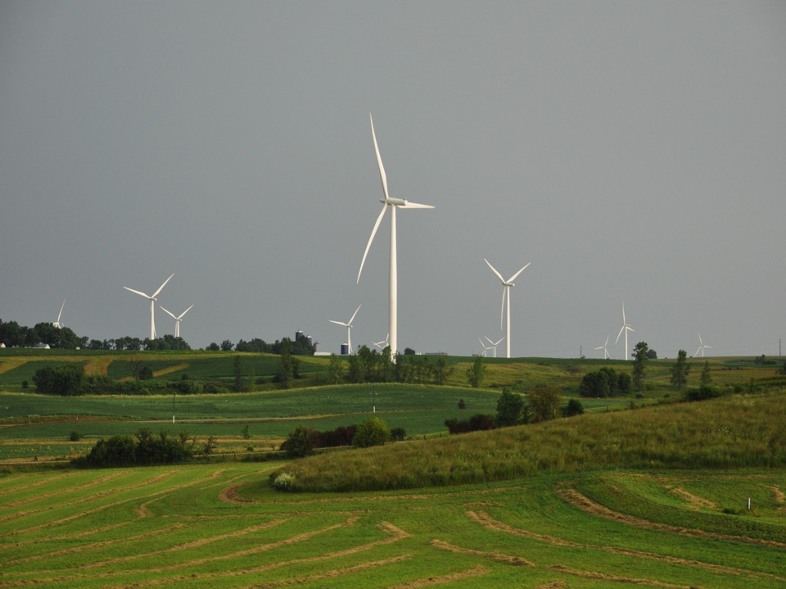
Outline:
History and Motivation
Field Experiments
Results from CWEX10/11
Beyond CWEX
Photo courtesy of Lisa H Brasche

Slide 6
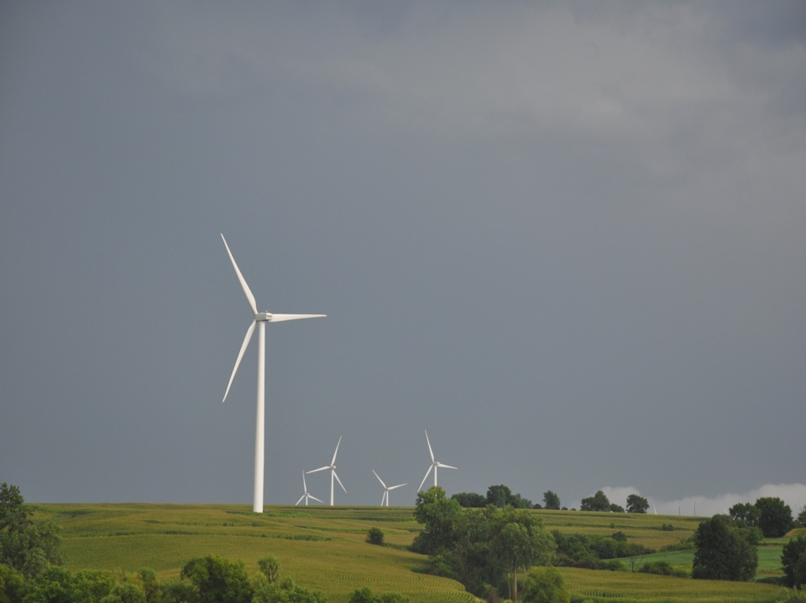
Crop/Wind-energy Experiment (CWEX)
Began 2009-2010 as a seed grant funded by the
Center for Global and Regional Environmental Research, U of Iowa
Seed funding from the Ames Laboratory, DOE, 2010
4 towers, 2 lidars, balloon: Anemometry Specialists, Inc 2012-13
4 flux stations: the National Laboratory for Agriculture and the Environment 2010
1-2 Windcubes: NREL/CU (Dr. Julie Lundquist) 2010, 2011
2 120-m towers: Iowa Power Fund, 2012
4 sodars, SCADA data: NextEra, 2012-13
4 flux stations: NCAR 2011
Photo courtesy of Lisa H Brasche

Slide 7
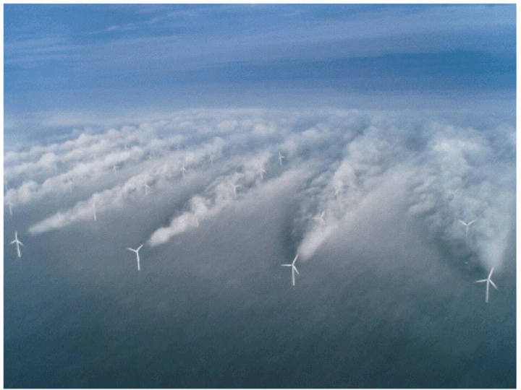
Source: UniFly A/S
Horns Rev 1 owned by Vattenfall. Photographer Christian Steiness.

Slide 8
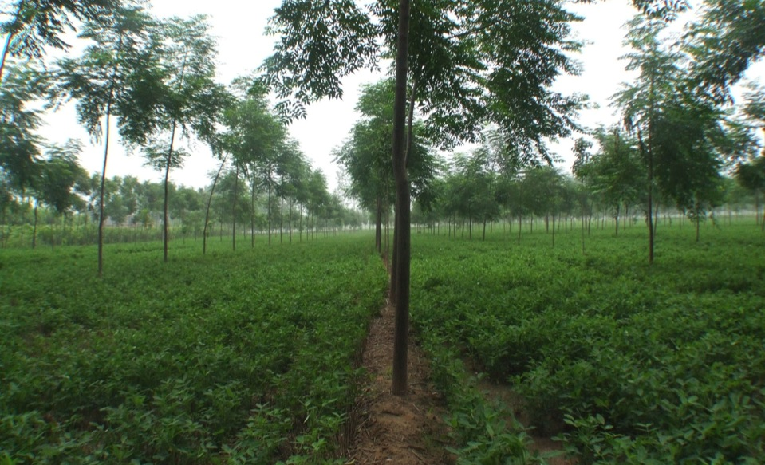
Some Inspiration from China

Slide 9
Conceptual Model of Turbine-crop Interaction via Mean Wind and Turbulence Fields
Speed recovery
day
H₂O
CO₂
Heat
__ ___________________________________
night

Slide 10
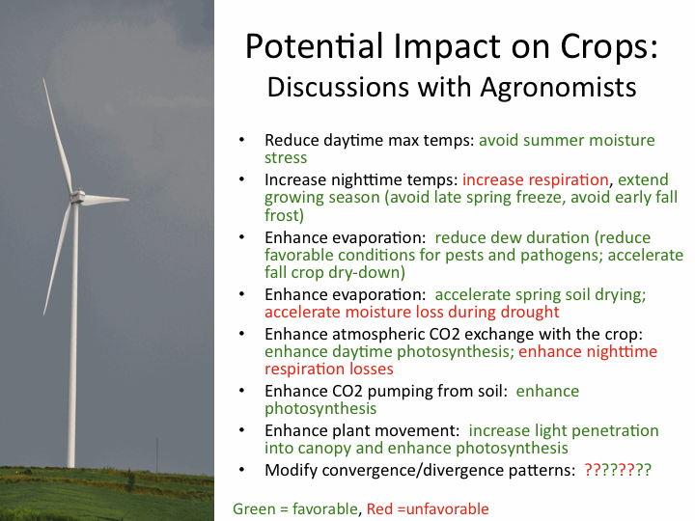
Photo courtesy of Lisa H Brasche

Slide 11
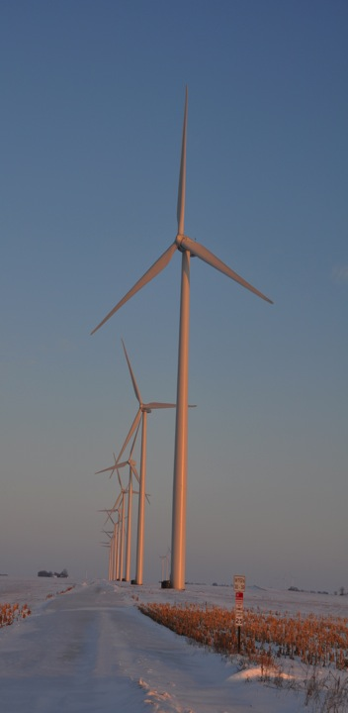
Turbine-Crop Interactions:
Overview
Do turbines create a measureable influence on the microclimate over crops?
If so, is this influence create measureable biophysical changes?
And if this is so, does this influence affect yield?
Agricultural shelterbelts have a positive effect on crop growth and yield.
Will wind turbines also have a positive effect?
Photo courtesy of Lisa H Brasche

Slide 12
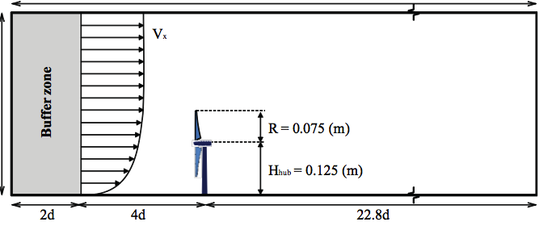
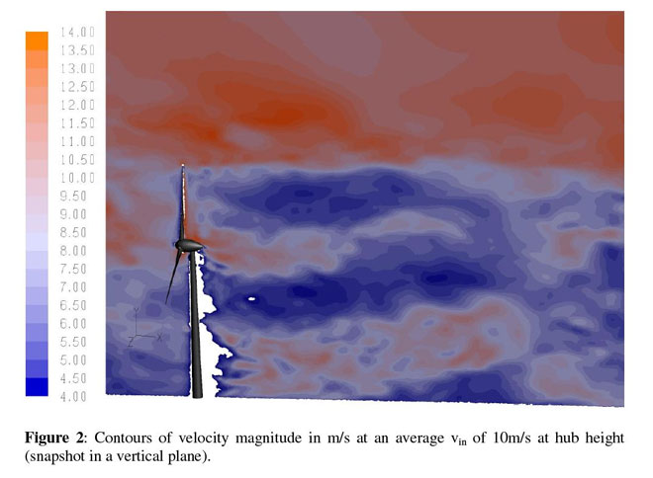
Porté-Agel, Lu, and Wu, 2010
Wuβow, Sitzki, & Hahn, 2007, CFD simulation using ANSYS FLUENT 6.3 LES

Slide 13
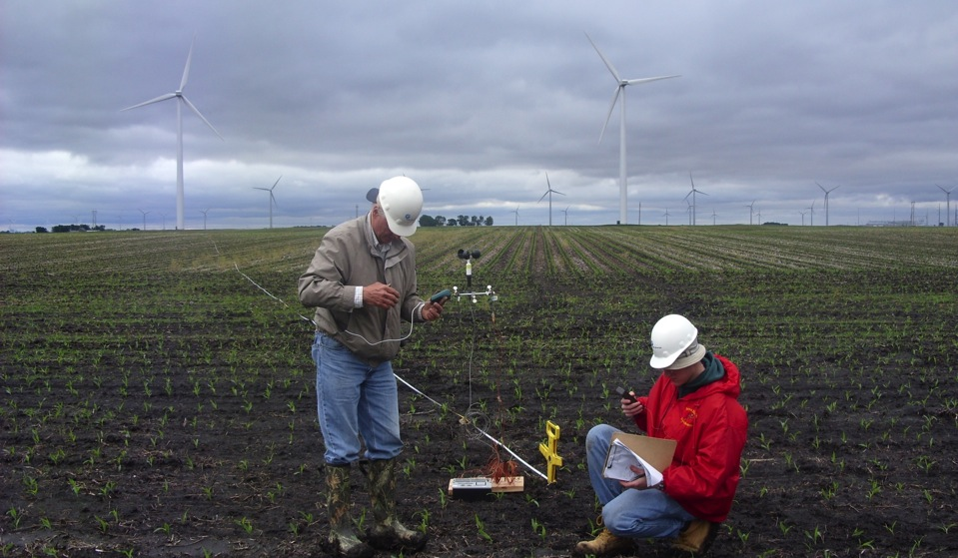
Preliminary Observations

Slide 14
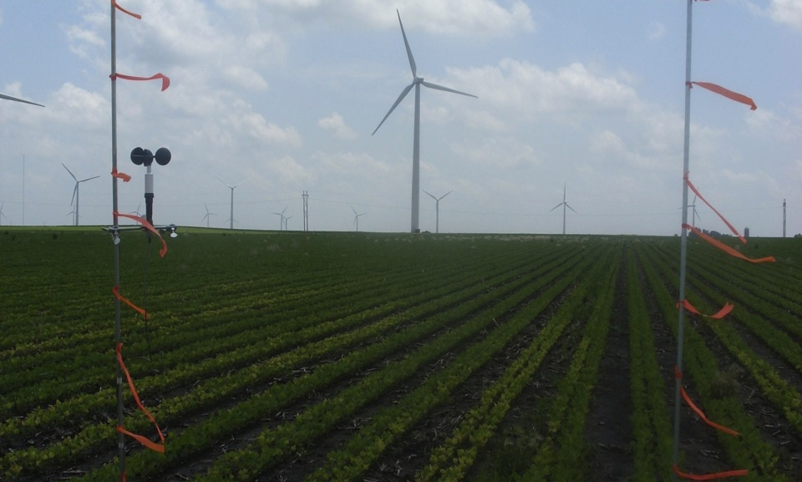
Low-Budget Beginnings

Slide 15
CWEX10 Field Experiment
Central Iowa wind farm ( 200 1.5-MW turbines)
Southern edge of a wind farm
Corn-soybean cropping pattern (measurements made in corn)
26 June – 7 September 2010; turbines off 0700 LST 26 July – 2300 LST 5 Aug 2300
4 Eddy Covariance flux towers
NREL/CU Lidar (J. Lundquist) (28 June-9 July)

Slide 17
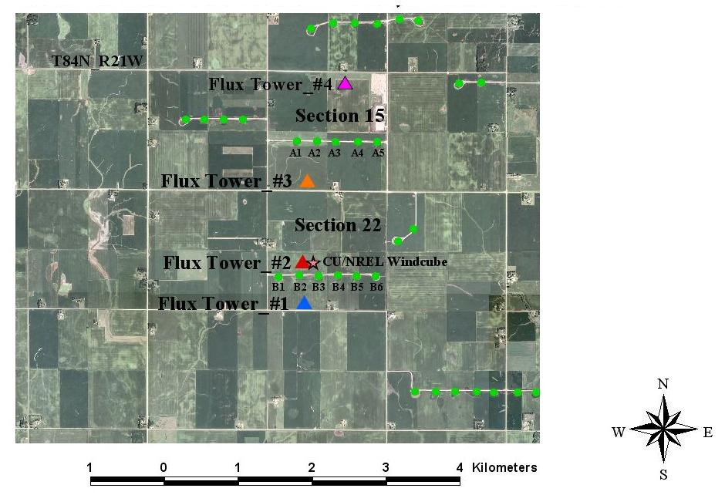
4 flux towers
  maize canopy
  26 June – 7 Sept, 2010
CU/NREL Lidar
  28 June - 9 July 2010

Slide 19
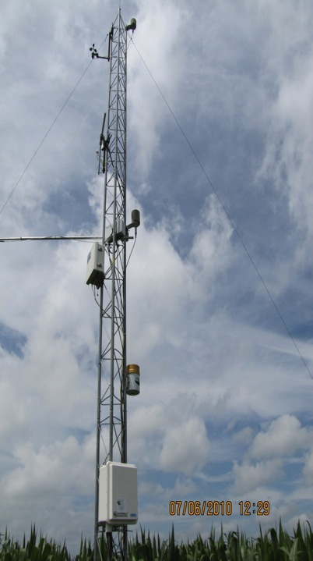
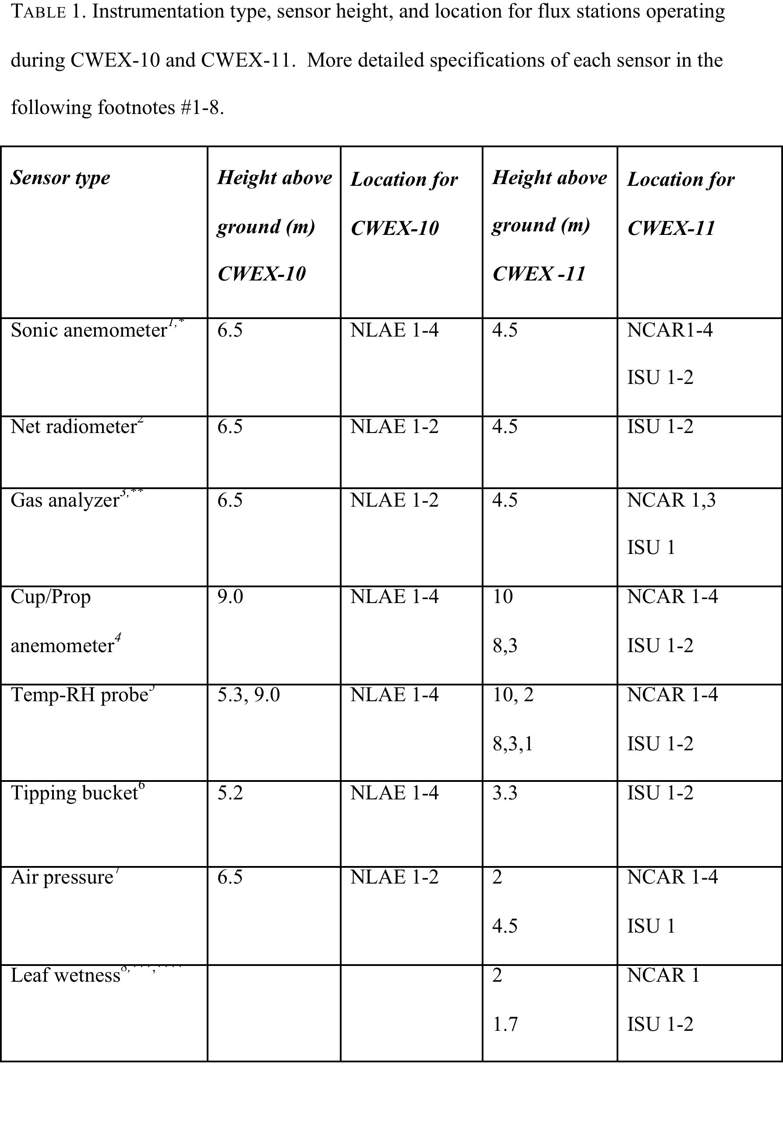

Slide 20
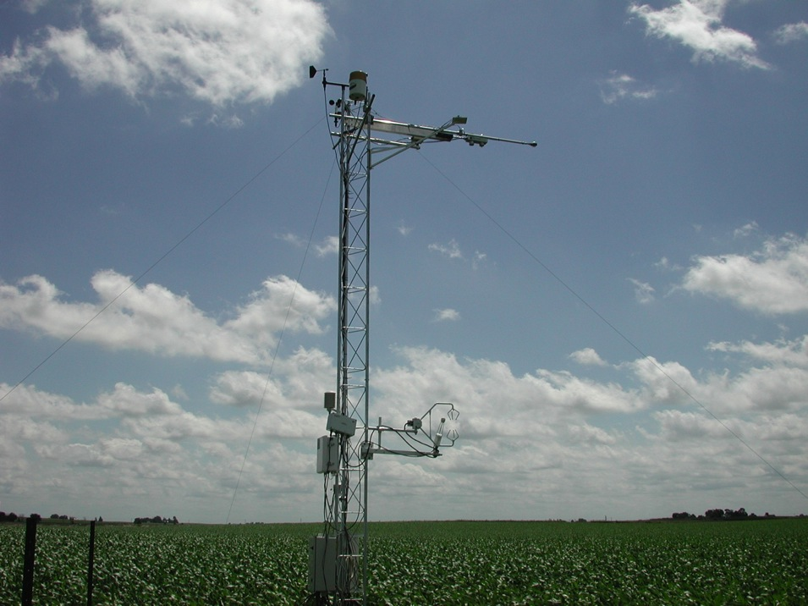

Slide 21
CWEX10 Data analysis
Focus on ‘differences’ in crop microclimate at flux tower locations
Pay attention to wind direction
Turbines on – turbines off
Isolate instrument and location biases
  Reference sonic temperature ~ 0.6-0.8ºC high
  possible influence from localized advection (large pond and wet field 1 km SE of the reference tower)

Slide 22
Wind Speed Difference
TKE Difference
CWEX-10 Results:
Differences in wind speed and TKE
Dependence on atmospheric stability
Dependence wake location
Daytime
Nighttime
Daytime
Nighttime
West Wind
(control case)
SW Wind
(under wake)
South wind
(between wakes)

Slide 23
Source: UniFly A/S
Horns Rev 1 owned by Vattenfall. Photographer Christian Steiness.

Slide 24
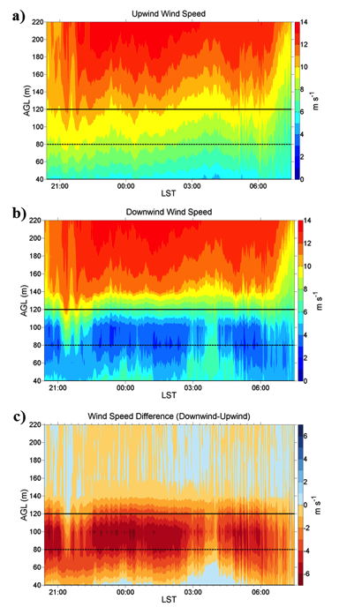
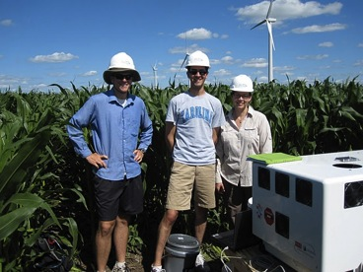
Vertically Pointing Lidar
Wind Speed Contours upwind and downwind of B-line of turbines (D = Rotor diameter, ~80 m)
16-17 July 2010
4.5 D South of B-turbines
Rotor Layer
2.0 D North of B-turbines
CU/NREL Lidar research team
Speed difference

Slide 25
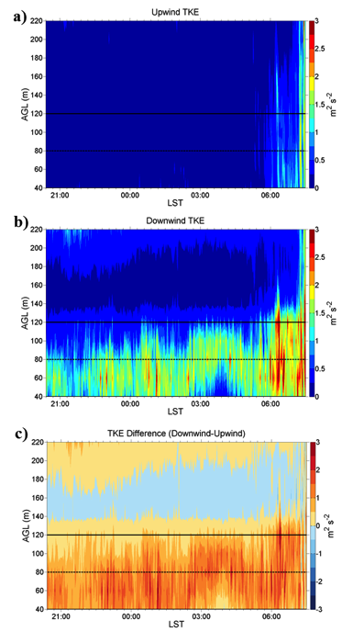
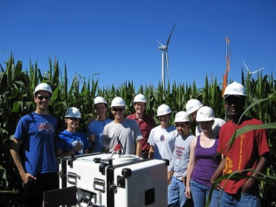
Vertically Pointing Lidar
Vertical profiles of turbulence kinetic energy (TKE)
16-17 July 2010
4.5 D South of B-turbines
Rotor Layer
2.0 D North of B-turbines
CU/NREL/ISU Lidar deployment team
TKE difference

Slide 26
Case study: 50-min period of wind farm shutdown in nighttime
Dan Rajewski

Slide 27
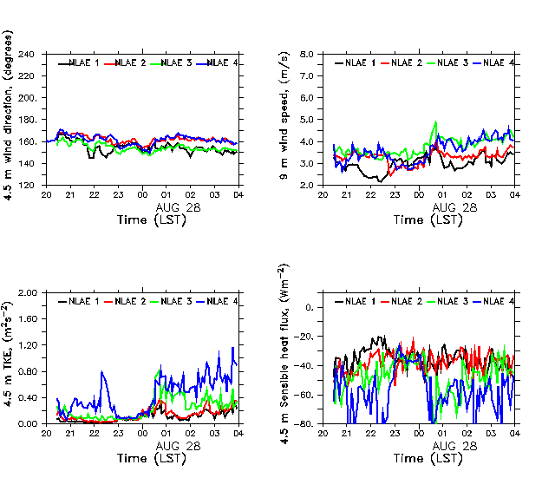
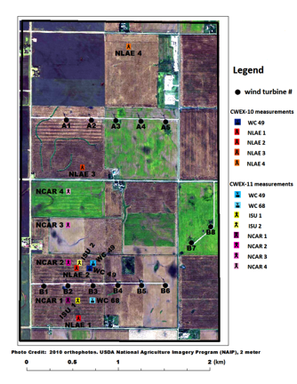
Turbines offline:
August 27, 2010 2300-0000 LST
Station north of two turbine lines has 2-3X ambient TKE and Heat flux before/after OFF period
80-m wind direction
vector
Return to reference flow
conditions during the shut
down

Slide 28
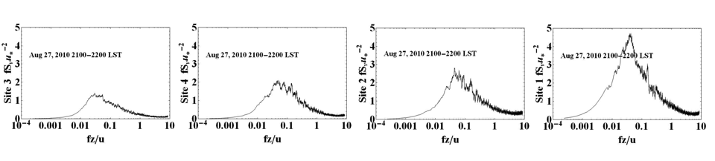
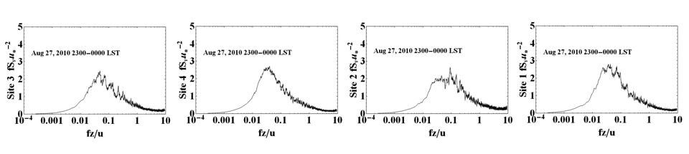
Spectral evidence before and during the shutdown period
V-power spectra
South → North
Turbines ON
NLAE 1
NLAE 2
NLAE 3
NLAE 4
South → North
Turbines OFF
NLAE 1
NLAE 2
NLAE 3
NLAE 4
ON: Increase in stream-wise momentum variance of: 1.5X downwind of first line of turbines
3.0X downwind of two lines of turbines
OFF: Similar intensity of variance for all flux stations south and north of two turbine lines

Slide 29
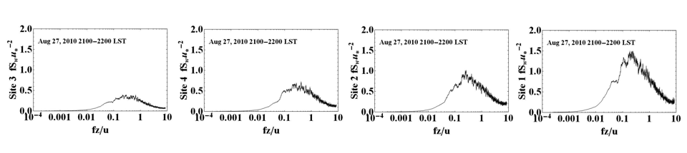
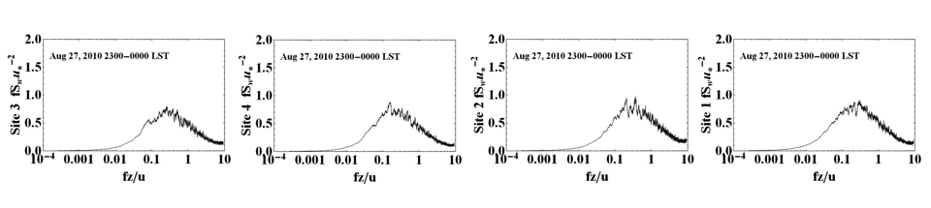
Spectral evidence before and during the shutdown period
W-power spectra
South → North
Turbines ON
NLAE 1
NLAE 2
NLAE 3
NLAE 4
South → North
Turbines OFF
NLAE 1
NLAE 2
NLAE 3
NLAE 4
ON: Increase in vertical velocity variance of: 2.0X downwind of first line of turbines
5.0X downwind of two lines of turbines
OFF: Similar intensity of variance for all flux stations south and north of two turbine lines

Slide 30
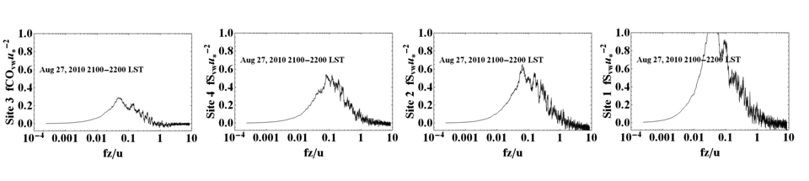
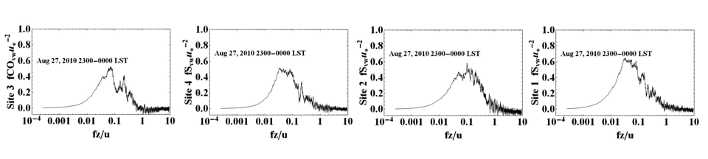
Spectral evidence before and during the shutdown period
VW-power spectra
South → North
Turbines ON
NLAE 1
NLAE 2
NLAE 3
NLAE 4
South → North
Turbines OFF
NLAE 1
NLAE 2
NLAE 3
NLAE 4
ON: Increase in stream-wise co-variance of 2.0X downwind of first line of turbines
4.0X downwind of two lines of turbines
OFF: Similar intensity of covariance for all flux stations south and north of two turbine lines

Slide 31
Summary
Turbine wake response is nearly instantaneous to changes in operational characteristics
Significant differences in both flow and microclimate are measurable for surface stations under the influence of two lines of turbines
Spectra of momentum and co-spectra of momentum co-variances demonstrate the asymmetric 3-D wake structure and the translation of this flow pattern to the surface

Slide 32
CWEX11 Field Campaign
Same location
Measure from June-August
Six measurement stations (instead of 4); four provided by National Center for Atmospheric Research
Two lidars (one upwind, one downwind of turbine line) provided by J. Lundquist, CU
Wind Energy Science, Engineering and Policy Research Experience for Undergraduates (REU) students involved

Slide 33
Higher
downwind
Wind Speed
TKE
Higher
downwind
Higher
downwind
Temperature
Heat Flux
Larger negative
downwind
Differences during the night of 16-17 July 2011 for (a) wind speed (b) TKE, (c) air temperature, and (d) sensible heat flux. Note that at the ISU tower wind speed and temperature are collected at the 8-m level while the NCAR tower wind speed and temperature are observed at 10 m.

Slide 34
Daytime H flux
2010
NCAR 3 has larger difference
In H than for NLAE 2-NLAE 1
2011

Slide 35
Daytime H flux (accumulated)
2% higher
downwind
2010
5% higher
downwind
2011

Slide 36
Daytime LE flux
2010
NCAR 3 has larger difference
In H than for NLAE 2-NLAE 1
2011

Slide 37
Daytime LE flux (accumulated)
2010
<2%
difference
3-4% higher
downwind
2011

Slide 38
Daytime CO2 uptake
2010
2011
July 24
NW to WNW
flow

Slide 39
Daytime CO2 accumulated uptake
2010
17% increase
downwind
2011
5% increase
downwind

Slide 40
Nighttime H flux
2010
2011

Slide 41
Nighttime H flux (accumulated)
2010
2-4% higher
downwind
Least amount of change during wind farm shut down
2011
2-4% higher
downwind

Slide 42
Nighttime LE flux
2010
Less occurrences of canopy
condensation during CWEX-11 so NCAR3-1 difference less substantial than NLAE 2-1 in CWEX-10
2011

Slide 43
Nighttime LE flux (accumulated)
2010
10-20% higher
downwind
20%-30% lower
downwind
2011

Slide 44
Nighttime CO2 production (absent soil respiration)
2010
July 21 NW flow at NLAE 1, optimal B2 wake position
Aug 13 SSE flow at NLAE 2, optimal B3 wake
2011
Aug 1 SSE wind B2 turbine off
Aug 2 SSE wind Hub speed > 8 m/s

Slide 45
Nighttime CO2 production (includes soil respiration)
2010
Narrowing of difference during wind farm shut down
2011
+5 to -5% difference

Slide 46
Total NEE (day+night)
2010
2011

Slide 47
Total NEE (day+night accumulated)
2010
18-20% increase
downwind
2011
10% increase
downwind

Slide 48
Turbine Influence on Surface Fluxes
2010 NLAE Instruments (6.45 m)
2011 NCAR Instruments (4.50 m)
Same maize field
Different maize fields
Daytime fluxes
  Sensible heat: <2%
  Latent heat: <2%
  CO₂ : -15% (higher uptake)
Nighttime fluxes
  Sensible heat: -2 to -4% (warms crop)
  Latent heat: +10-20% (less dew)
  CO₂: +10% (more respiration)
Net ecosystem exchange*
  +18-20% (increased uptake by crop)
Daytime fluxes
  Sensible heat: +5% (cools crop)
  Latent heat: +3 to +4% (dries crop)
  CO2: -5 to -10% (higher uptake)
Nighttime fluxes
  Sensible heat: -5-15% (warms crop)
  Latent heat: -20-30% (more dew)
  CO₂: +5 to -5% (indeterminate)
Net ecosystem exchange*
  +10% (increased uptake by crop)
* Soil respiration not included

Slide 49
Surface Pressure Perturbation Produced by a Line of Turbines

Slide 50
ISU 2
N
B1
B5
ISU 1

Slide 51
Wake from B1
B1
B5

Slide 52
B1
B5
H

Slide 53
Surface pressure field
L
B1
B5
H

Slide 54
Surface pressure field
L
B1
B5
H
Wang, H., E. S. Takle, and J. Shen, 2001: Shelterbelts and Windbreaks: Mathematical
Modeling and Computer Simulation of Turbulent Flows. Ann. Rev. Fluid Mech., 33,
549-586. (Invited review paper)

Slide 55
B1
B5

Slide 56
B1
B5

Slide 57
B1
B5

Slide 58
B1
B5

Slide 59
B1
B5

Slide 60
B1
B5

Slide 61
B1
B5
H

Slide 62
L
B1
B5
H

Slide 63
L
B1
B5
H
Grad P
F

Slide 64
Wake from B1
B1
B5

Slide 65
Wake from B1
B1
B5
Wang, H., and E. S. Takle, 1996: On three-dimensionality of shelterbelt structure
and its influences on shelter effects. Bound.-Layer Meteor. 79, 83-105.

Slide 66
Sfc
Wake from B1
B1
B5
Sfc

Slide 67
Wake from B1
B1
B5

Slide 68
Southerly Winds, SW at Surface
Backing wind at ISU 2
under stable conditions

Slide 69
Wake from B4
B1
B5

Slide 70
Southerly winds, SE at Surface
Veering wind at ISU 2
under stable conditions

Slide 71
LLJ
N
LLJ
?
Sfc
Sfc

Slide 72
Surface Pressure Perturbation Produced by a Line of Turbines
Important factor in driving near-turbine surface flow, especially speed-up in the lee
Some evidence that this pressure field leads to surface convergence within the wind farm
Need to deploy a network of high-accuracy barometers (nanobarometers) to map out the perturbation pressure field both near turbines and across the wind farm

Slide 73
Key Messages
Temperature increases at night in lee of turbines
Temperature decreass during day in lee of the turbines
Wind speed increases in the near lee of the turbines, more for stable flow
Significant wind shear from surface to nacelle particularly under stable flow
Downward CO₂ flux is enhanced during day in lee of the turbines
Some evidence for surface layer convergence across a line of turbines

Slide 74
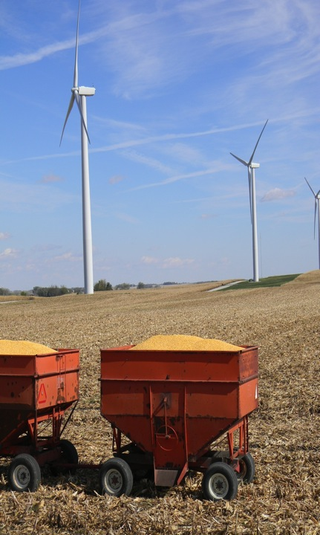
Initial Movitation:
  Do changes in temperature, humidity, wind speed, turbulence, and CO₂ due to wind turbines influence crop growth and yield?
Public acceptance of wind turbines
  Multi-use, high-land-value environment
  Crops are tuned to climate conditions
  Beyond CWEX:
Testbed for validating high-resolution wind-farm models and coupling to sfc and PBL
  General understanding of impacts of turbines
  Understand turbine-turbine interaction and wind-farm performance
  Options for further wind farm build-out: Go higher? More dense?
  Iowa has a flat terrain, strong LLJ, not unlike coastal jets, many existing windfarms and component manufacturers: good zero-order testbed for off-shore as well as onshore technologies

Slide 75
Measurements Needed
Additional surface flux measurements (middle of wind farm)
Surface pressure field across turbine line
Vertical profiles of horizontal velocity through the turbine layer (H)
Horizontal velocities across the wind farm (convergence?)
Turbulence in and above the turbine layer with the layer above (H-2H); also vertical velocity above the turbine layer
Diurnal changes of u, T, RH, turbulence in H-10H
Low-level jet characteristics

Slide 76
Analysis Needed
Surface flux anomalies
Wake structure – dependence on stability, speed and direction shear
Coupling of the turbine layer with the layer above (H-2H)
Horizontal convergence in the H layer
Diurnal changes in H-10H
Low-level jet characteristics

Slide 77
Modeling Needed
Diurnal changes of surface fluxes
Coupling of the turbine layer with the layer above (H-2H)
Horizontal convergence in the H layer
Diurnal changes in H-10H
Low-level jet characteristics
Turbine-turbine interactions (wake characteristics)
Shear and turbulence coupling to blade stresses

Slide 78
Potential Future Contributions from CWEX
200-turbine utility scale test bed
Flat terrain allows clarity for exploring fundamental interactions of the wind farm with the PBL
Strong diurnal changes in surface layer stratification and resulting shear in speed and direction
Strong Low-Level Jet characteristic of the Central US high wind resource region (similarities to coastal jets as well, horizontal uniformity)
Seasonal land surface change characteristics
Cooperative land owners, multiple field sites
NDA with wind farm operator, access to SCADA data

Slide 79
Current Status:
Research Capacity
Three seasons of successful instrument deployment
NSF Research Experiences for Undergraduates (REU) site program (2011-2013) for Wind Energy Science, Engineering and Policy (WESEP)
NSF Integrated Graduate Education, Research, and Training (IGERT) in WESEP (2012-2017)
Undergraduate minor in WESEP
EPSCoR funding for new faculty position in wind farm modeling

Slide 80
Current Status:
Instrumentation
EPSCoR funding for two 120-m instrumented towers
EPSCoR funding for network of surface stations
IGERT funding for nanobarometer network
State of Iowa funding for partnership with a private company for developing a tethered balloon measurement platform (loan of 4 50-m towers, 2 lidars)
Wind farm owner is redeploying 4 sodars to the CWEX site

Slide 81
Collaborations being Planned
National Laboratory for Agriculture and the Environment will be deploying instruments nearby-but-outside this wind farm in 2013-2015
US Agriculture Research Service plans major field campaign (air-craft, surface, satellite special obs) in 2015
NASA plans major field campaign for satellite soil moisture obs in nearby watershed in 2015

Slide 82
Summary
CWEX10/11 have demonstrated the feasibility of a major wind farm observing capability in a high-wind resource region of the US.
Educational component in place
Strong interest from
  private sector (ASI, MEC, NextEra)
  State of Iowa
  Iowa State University
  Federal agencies (NLAE, ARS, NASA, NCAR)
  University collaborators

Slide 83
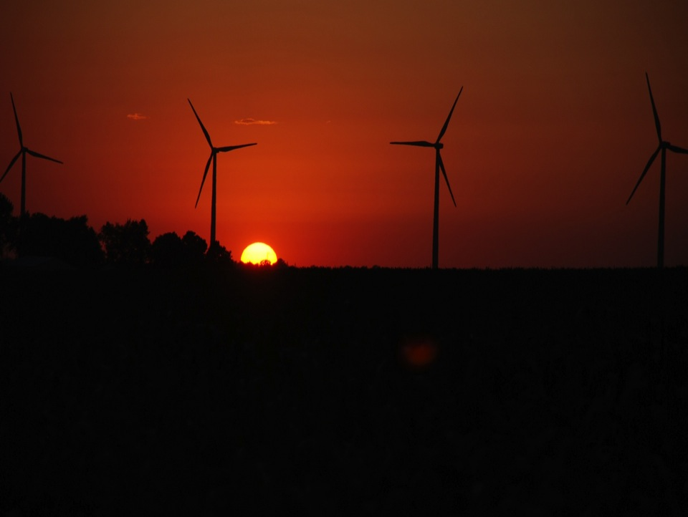
ACKNOWLEDGMENTS
Julie Lundquist for slides from presentation at LANL
Dr. Ron Huhn, property owner
Gene and Todd Flynn, farm operators
Lisa Brasche for photos
Equipment and personnel supplied by the National Laboratory for Agriculture and
the Environment
Funding supplied by
Center for Global and Regional Environmental Research, University of Iowa
MidAmerican Energy Company
Ames Laboratory , Department of Energy
National Science Foundation
Photo courtesy of Lisa H Brasche

Slide 84
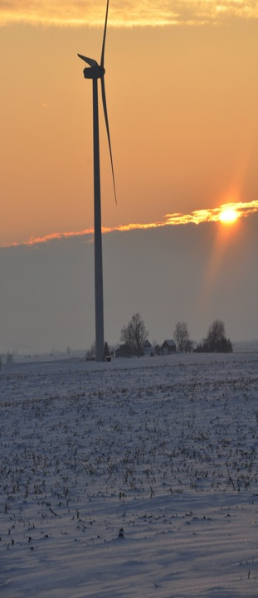
For More Information
Eugene S. Takle
gstakle@iastate.edu
http://www.meteor.iastate.edu/faculty/takle/
515-294-9871
Julie K. Lundquist
Julie.Lundquist@colorado.edu
Julie.Lundquist@nrel.gov
http://atoc.colorado.edu/~jlundqui
303/492-8932 (@CU)
303/384-7046 (@NWTC)
Photo courtesy of Lisa H Brasche

